Slide 1
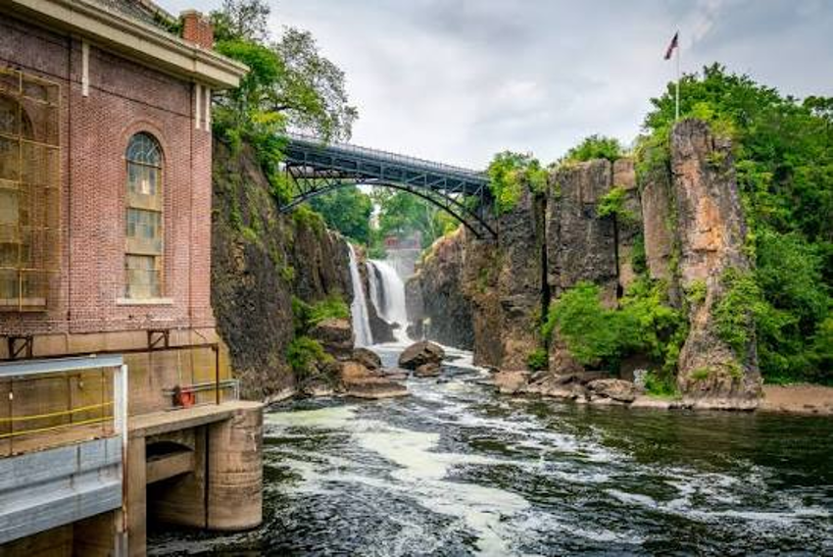
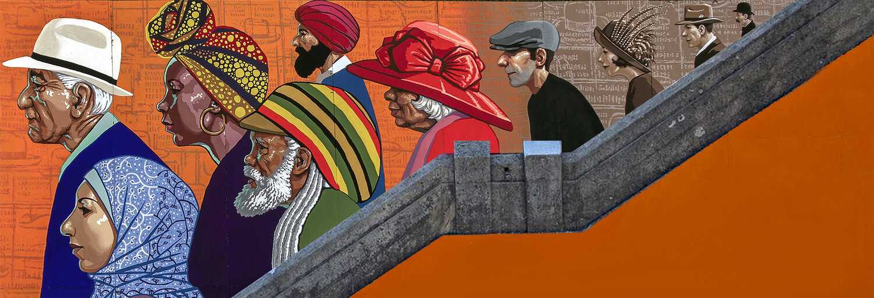
About I.C. New Jersey

Slide 2
I.C. New Jersey purposes
Leverage the power of heritage, culture, collaboration and creativity to accelerate community and economic development across New Jersey
Generate hundreds of millions of $ in economic impact, support thousands of jobs, attract sustainable and community-supported investment
Special focus on communities with high concentrations of ALICE residents, or that tend to get less support from grantmaking, destination marketing or economic development initiatives
Build sustainable wealth through cultural entrepreneurship
Elevate undervalued elements of New Jersey’s heritage: industry & innovation, migration & immigration, transportation & infrastructure, suburbia & planned communities
Promote understanding, reduce tensions and increase collaboration within and between communities
Benefiting communities in at least 12 counties in New Jersey: Bergen, Camden, Essex, Hudson, Mercer, Middlesex, Monmouth, Morris, Passaic, Sussex, Union, Warren

Slide 3
Why?
Circulating more of the enormous wealth in and around New Jersey into more communities will build shared prosperity
Encouraging New Jersey residents to visit communities they are unfamiliar with will foster understanding, empathy and collaboration
Understanding how we became a state of innovation will help generate more investment and innovation in New Jersey
Elevating the diverse heritage and cultures in New Jersey will help more people feel a sense of belonging in their municipality, county and the state overall
National recognition of New Jersey’s innovation ecosystem and industrial heritage can generate large and long-term investments

Slide 4
I.C. New Jersey Elements
National Heritage Area (NHA) Project
Cultural Heritage Asset Inventory (CHAI)
Philanthropic Consortium
Community Investments (Placemaking)
Thematic place marketing

Slide 5

National Heritage Area project
Generates prestige and recognition for our distinctive heritage and assets
Supports cultural heritage tourism and other community investments
Provides up to $1 million annually in federal funding, most of which to be distributed as grants to nonprofits and local governments. Funds can cover a wide array of projects
Geographic area and focus to be determined based on Feasibility Study (now underway)

Slide 6
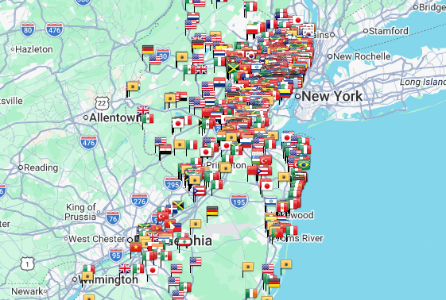
Cultural Heritage Asset Inventory (CHAI)
Lists historic and cultural sites and places, public art, and other heritage elements (such as culturally-themed restaurants)
Can support cultural heritage tourism
Can support asset-based community and economic development
Note: Map from EthnicNJ.com for example purposes only

Slide 7
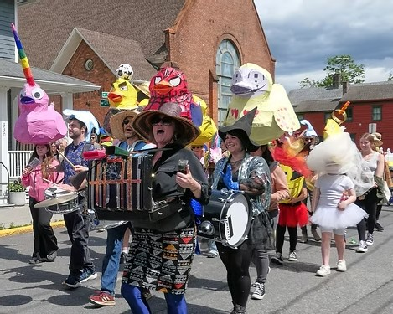
Community investments
Long-term engagement by Northern New Jersey Community Foundation in municipalities to expedite community benefits and increase impacts
NNJCF investments include:
  Better connections to funding
  Greater access to knowledge and resources
  Expertise in community economic development and creative placemaking
Partnering with Orton Family Foundation on Community Heart & Soul program

Slide 8

Philanthropic consortium
Consortium of grantmakers and public agencies that work in more than one municipality
Help coordinate philanthropic investments in communities by grantmakers, public agencies, corporate funders and others to expedite benefits and increase impacts
Guide grantmaking of NHA funds

Slide 9
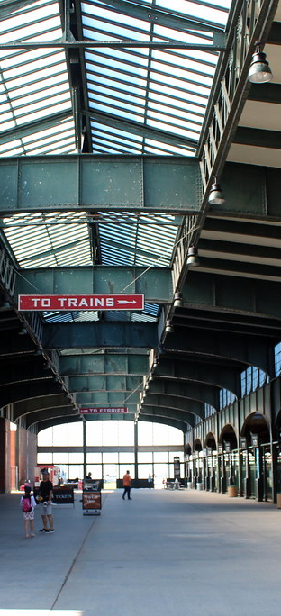
Thematic Place Marketing
Promote our distinct and interconnected heritage in:
  Industry & innovation
  Migration & immigration
  Transportation & infrastructure
  Suburbia & planned communities
Encourage visitation – not just of sites, but also places
North Jersey Stories and links to other heritage- and destination-related podcasts, blogs and websites
This Photo by Unknown Author is licensed under CC BY-NC-ND

